Slide 1

Keras for Deep Learning Research

Slide 2
Agenda
Quick Review of Previous Topics and NNs
Convolutional Neural Networks (CNN)
Hyperparameters
Use case:
Image classification with CNN

Slide 3
Let's quickly review what we've covered so far!

Slide 4
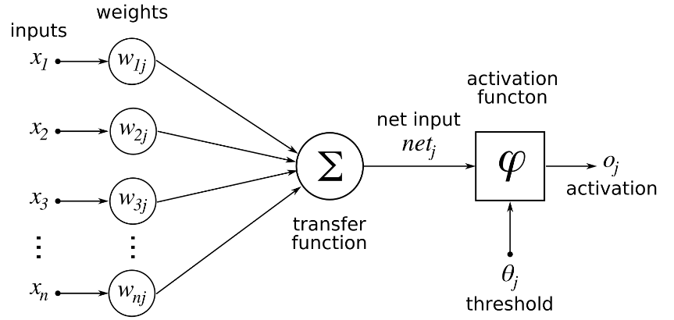
Deep Learning
Single Neuron
We now understand how to perform a calculation in a neuron
w · x + b = z
a = σ(z)
Source: https://www.udemy.com/complete-guide-to-tensorflow-for-deep-learning-with-python/learn/v4/overview

Slide 5
Deep Learning
Activation Functions
Step Function
Sigmoid
Rectifier
Hyperbolic Tangent(tanh)
Source: https://www.udemy.com/complete-guide-to-tensorflow-for-deep-learning-with-python/learn/v4/overview

Slide 6
Deep Learning
Connecting Neurons to create a network
Source: https://www.udemy.com/complete-guide-to-tensorflow-for-deep-learning-with-python/learn/v4/overview

Slide 7
Deep Learning
Neural Network
Input Layer
Hidden Layers
Output Layer
More layers → More Abstraction
Source: https://www.udemy.com/complete-guide-to-tensorflow-for-deep-learning-with-python/learn/v4/overview

Slide 8
Deep Learning
To "learn" we need some measurement of error
We use a Cost/Loss Function
Mean Square Error
Cross-Entropy
Source: https://www.udemy.com/complete-guide-to-tensorflow-for-deep-learning-with-python/learn/v4/overview

Slide 9
Deep Learning
Once we have the measurement of error, we need to minimize it by choosing the correct weight and bias values
We use gradient descent to find the optimal values
Source: https://www.udemy.com/complete-guide-to-tensorflow-for-deep-learning-with-python/learn/v4/overview

Slide 10
Deep Learning
Gradient descent : We then backpropagate from the output layer back to the input layer, through multiple layers to learn the weights.
Source: https://www.udemy.com/complete-guide-to-tensorflow-for-deep-learning-with-python/learn/v4/overview

Slide 11
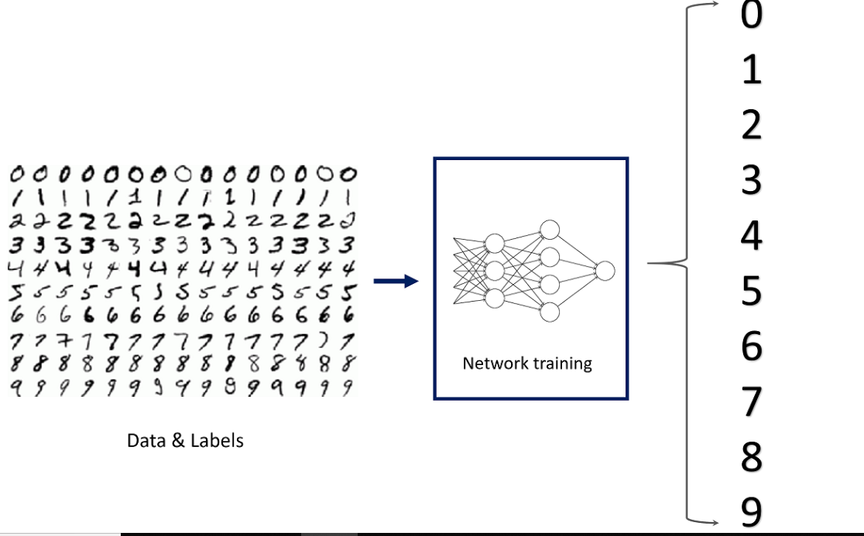
Previously we learned: Image classification on MNIST dataset using NN
.

Slide 12
Convolutional Neural Network (CNN)

Slide 13
Convolutional Neural Network
Just like the simple perceptron, CNNs also have their origins in biological research
Inspirational work by Hubel and Wiesel who studied the structure of the visual cortex in mammals, winning a Nobel Prize in 1981
Source: https://en.wikipedia.org/wiki/Convolutional_neural_network

Slide 14
Convolutional Neural Network
Their research revealed that neurons in the visual cortex had a small local receptive field
This idea then inspired an ANN architecture that is CNN
Source: https://en.wikipedia.org/wiki/Convolutional_neural_network

Slide 15
Convolutional Neural Network
There are four main operations in the CNN
Convolutions and Filters
Pooling or Sub Sampling
Non Linearity
Classification (Fully Connected Layer)
Source: https://ujjwalkarn.me/2016/08/11/intuitive-explanation-convnets/

Slide 16

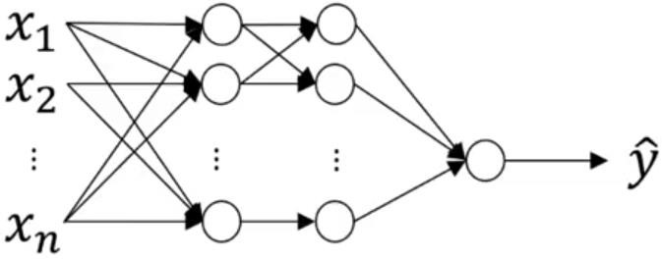
Traditional Neural Network vs CNN
32 x 32 x 3 = 3072
1000
32
_{W}12
1000 x 3072
dimensional matrix
32

Slide 17
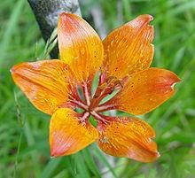
Traditional Neural Network vs CNN
1000 x 1000 x 3 = 3,000,000
1000
1000
_{W}12
1000 x 3,000,000
dimensional matrix!!!
= 3,000,000,000 features
1000

Slide 18
Traditional Neural Network vs CNN
Salient points:
Spatial relationship between features in image is not considered in NN
NN is not feasible for large images!
In order to perform Computer Vision operations on large images, convolution operation plays an important role
Thus, CNNs are fundamentally important

Slide 19
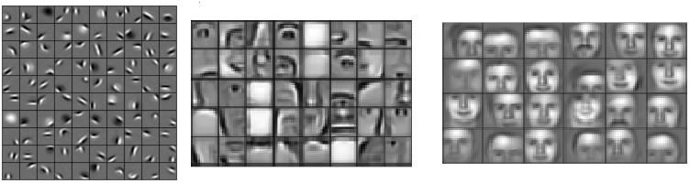
Stages of feature extraction
Low level features
Mid level features
High level features
Edges, curves and colour
Parts of objects
Complete objects

Slide 20
Foundation of Convolutional Neural Networks
Vertical Edge Detection
3 | 0 | 1 | 2 | 7 | 4
1 | 5 | 8 | 9 | 3 | 1
2 | 7 | 2 | 5 | 1 | 3
0 | 1 | 3 | 1 | 7 | 8
4 | 2 | 1 | 6 | 2 | 8
2 | 4 | 5 | 2 | 3 | 9
-1 | 0 | 1
-1 | 0 | 1
-1 | 0 | 1
*
=

Slide 21
Foundation of Convolutional Neural Networks
Vertical Edge Detection
3 | -1 | 0 | 0 | 1 | 1 | 2 | 7 | 4
1 | -1 | 5 | 0 | 8 | 1 | 9 | 3 | 1
2 | -1 | 7 | 0 | 2 | 1 | 5 | 1 | 3
0 |  | 1 |  | 3 |  | 1 | 7 | 8
4 |  | 2 |  | 1 |  | 6 | 2 | 8
2 |  | 4 |  | 5 |  | 2 | 3 | 9
5
-1 | 0 | 1
-1 | 0 | 1
-1 | 0 | 1
*
=

Slide 22
Foundation of Convolutional Neural Networks
Vertical Edge Detection
3 | 0 | -1 | 1 | 0 | 2 | 1 | 7 | 4
1 | 5 | -1 | 8 | 0 | 9 | 1 | 3 | 1
2 | 7 | -1 | 2 | 0 | 5 | 1 | 1 | 3
0 | 1 |  | 3 |  | 1 |  | 7 | 8
4 | 2 |  | 1 |  | 6 |  | 2 | 8
2 | 4 |  | 5 |  | 2 |  | 3 | 9
5 | 4
-1 | 0 | 1
-1 | 0 | 1
-1 | 0 | 1
*
=

Slide 23
Foundation of Convolutional Neural Networks
Vertical Edge Detection
3 | 0 | 1 | -1 | 2 | 0 | 7 | 1 | 4
1 | 5 | 8 | -1 | 9 | 0 | 3 | 1 | 1
2 | 7 | 2 | -1 | 5 | 0 | 1 | 1 | 3
0 | 1 | 3 |  | 1 |  | 7 |  | 8
4 | 2 | 1 |  | 6 |  | 2 |  | 8
2 | 4 | 5 |  | 2 |  | 3 |  | 9
5 | 4 | 0
-1 | 0 | 1
-1 | 0 | 1
-1 | 0 | 1
*
=

Slide 24
Foundation of Convolutional Neural Networks
Vertical Edge Detection
3 | 0 | 1 | 2 | -1 | 7 | 0 | 4 | 1
1 | 5 | 8 | 9 | -1 | 3 | 0 | 1 | 1
2 | 7 | 2 | 5 | -1 | 1 | 0 | 3 | 1
0 | 1 | 3 | 1 |  | 7 |  | 8
4 | 2 | 1 | 6 |  | 2 |  | 8
2 | 4 | 5 | 2 |  | 3 |  | 9
5 | 4 | 0 | -8
-1 | 0 | 1
-1 | 0 | 1
-1 | 0 | 1
*
=

Slide 25
Foundation of Convolutional Neural Networks
Vertical Edge Detection
3 | 0 | 1 | 2 | 7 | 4
-1 1 | 0 5 | 1 8 | 9 | 3 | 1
₂ -1 | ₇ 0 | ₂ 1 | 5 | 1 | 3
₀ -1 | ₁ 0 | ₃ 1 | 1 | 7 | 8
4 | 2 | 1 | 6 | 2 | 8
2 | 4 | 5 | 2 | 3 | 9
5 | 4 | 0 | -8
10
-1 | 0 | 1
-1 | 0 | 1
-1 | 0 | 1
*
=

Slide 26
Foundation of Convolutional Neural Networks
Vertical Edge Detection
3 | 0 | 1 | 2 | 7 | 4
1 | -1 5 | 0 8 | 1 9 | 3 | 1
2 | ₇ -1 | ₂ 0 | ₅ 1 | 1 | 3
0 | ₁ -1 | ₃ 0 | ₁ 1 | 7 | 8
4 | 2 | 1 | 6 | 2 | 8
2 | 4 | 5 | 2 | 3 | 9
5 | 4 | 0 | -8
10 | 2
-1 | 0 | 1
-1 | 0 | 1
-1 | 0 | 1
*
=

Slide 27
Foundation of Convolutional Neural Networks
Vertical Edge Detection
3 | 0 | 1 | 2 | 7 | 4
1 | 5 | -1 8 | 0 9 | 1 3 | 1
2 | 7 | ₂ -1 | ₅ 0 | ₁ 1 | 3
0 | 1 | ₃ -1 | ₁ 0 | ₇ 1 | 8
4 | 2 | 1 | 6 | 2 | 8
2 | 4 | 5 | 2 | 3 | 9
5 | 4 | 0 | -8
10 | 2 | 2
-1 | 0 | 1
-1 | 0 | 1
-1 | 0 | 1
*
=

Slide 28
Foundation of Convolutional Neural Networks
Vertical Edge Detection
3 | 0 | 1 | 2 | 7 | 4
1 | 5 | 8 | -1 9 | 0 3 | 1 1
2 | 7 | 2 | ₅ -1 | ₁ 0 | ₃ 1
0 | 1 | 3 | ₁ -1 | ₇ 0 | ₈ 1
4 | 2 | 1 | 6 | 2 | 8
2 | 4 | 5 | 2 | 3 | 9
5 | 4 | 0 | -8
10 | 2 | 2 | -3
-1 | 0 | 1
-1 | 0 | 1
-1 | 0 | 1
*
=

Slide 29
Foundation of Convolutional Neural Networks
Vertical Edge Detection
3 | 0 | 1 | 2 | 7 | 4
1 | 5 | 8 | 9 | 3 | 1
₂ -1 | ₇ 0 | ₂ 1 | 5 | 1 | 3
₀ -1 | ₁ 0 | ₃ 1 | 1 | 7 | 8
₄ -1 | ₂ 0 | ₁ 1 | 6 | 2 | 8
2 | 4 | 5 | 2 | 3 | 9
5 | 4 | 0 | -8
10 | 2 | 2 | -3
0
-1 | 0 | 1
-1 | 0 | 1
-1 | 0 | 1
*
=

Slide 30
Foundation of Convolutional Neural Networks
Vertical Edge Detection
3 | 0 | 1 | 2 | 7 | 4
1 | 5 | 8 | 9 | 3 | 1
2 | ₇ -1 | ₂ 0 | ₅ 1 | 1 | 3
0 | ₁ -1 | ₃ 0 | ₁ 1 | 7 | 8
4 | ₂ -1 | ₁ 0 | ₆ 1 | 2 | 8
2 | 4 | 5 | 2 | 3 | 9
5 | 4 | 0 | -8
10 | 2 | 2 | -3
0 | 2
-1 | 0 | 1
-1 | 0 | 1
-1 | 0 | 1
*
=

Slide 31
Foundation of Convolutional Neural Networks
Vertical Edge Detection
3 | 0 | 1 | 2 | 7 | 4
1 | 5 | 8 | 9 | 3 | 1
2 | 7 | ₂ -1 | ₅ 0 | ₁ 1 | 3
0 | 1 | ₃ -1 | ₁ 0 | ₇ 1 | 8
4 | 2 | ₁ -1 | ₆ 0 | ₂ 1 | 8
2 | 4 | 5 | 2 | 3 | 9
5 | 4 | 0 | -8
10 | 2 | 2 | -3
0 | 2 | 4
-1 | 0 | 1
-1 | 0 | 1
-1 | 0 | 1
*
=

Slide 32
Foundation of Convolutional Neural Networks
Vertical Edge Detection
3 | 0 | 1 | 2 | 7 | 4
1 | 5 | 8 | 9 | 3 | 1
2 | 7 | 2 | ₅ -1 | ₁ 0 | ₃ 1
0 | 1 | 3 | ₁ -1 | ₇ 0 | ₈ 1
4 | 2 | 1 | ₆ -1 | ₂ 0 | ₈ 1
2 | 4 | 5 | 2 | 3 | 9
5 | 4 | 0 | -8
10 | 2 | 2 | -3
0 | 2 | 4 | 7
-1 | 0 | 1
-1 | 0 | 1
-1 | 0 | 1
*
=

Slide 33
Foundation of Convolutional Neural Networks
Vertical Edge Detection
3 | 0 | 1 | 2 | 7 | 4
1 | 5 | 8 | 9 | 3 | 1
2 | 7 | 2 | 5 | 1 | 3
₀ -1 | ₁ 0 | ₃ 1 | 1 | 7 | 8
₄ -1 | ₂ 0 | ₁ 1 | 6 | 2 | 8
₂ -1 | ₄ 0 | ₅ 1 | 2 | 3 | 9
5 | 4 | 0 | -8
10 | 2 | 2 | -3
0 | 2 | 4 | 7
3
-1 | 0 | 1
-1 | 0 | 1
-1 | 0 | 1
*
=

Slide 34
Foundation of Convolutional Neural Networks
Vertical Edge Detection
3 | 0 | 1 | 2 | 7 | 4
1 | 5 | 8 | 9 | 3 | 1
2 | 7 | 2 | 5 | 1 | 3
0 | ₁ -1 | ₃ 0 | ₁ 1 | 7 | 8
4 | ₂ -1 | ₁ 0 | ₆ 1 | 2 | 8
2 | ₄ -1 | ₅ 0 | ₂ 1 | 3 | 9
5 | 4 | 0 | -8
10 | 2 | 2 | -3
0 | 2 | 4 | 7
3 | 2
-1 | 0 | 1
-1 | 0 | 1
-1 | 0 | 1
*
=

Slide 35
Foundation of Convolutional Neural Networks
Vertical Edge Detection
3 | 0 | 1 | 2 | 7 | 4
1 | 5 | 8 | 9 | 3 | 1
2 | 7 | 2 | 5 | 1 | 3
0 | 1 | ₃ -1 | ₁ 0 | ₇ 1 | 8
4 | 2 | ₁ -1 | ₆ 0 | ₂ 1 | 8
2 | 4 | ₅ -1 | ₂ 0 | ₃ 1 | 9
5 | 4 | 0 | -8
10 | 2 | 2 | -3
0 | 2 | 4 | 7
3 | 2 | 3
-1 | 0 | 1
-1 | 0 | 1
-1 | 0 | 1
*
=

Slide 36
Foundation of Convolutional Neural Networks
Vertical Edge Detection
3 | 0 | 1 | 2 | 7 | 4
1 | 5 | 8 | 9 | 3 | 1
2 | 7 | 2 | 5 | 1 | 3
0 | 1 | 3 | ₁ -1 | ₇ 0 | ₈ 1
4 | 2 | 1 | ₆ -1 | ₂ 0 | ₈ 1
2 | 4 | 5 | ₂ -1 | ₃ 0 | ₉ 1
5 | 4 | 0 | -8
10 | 2 | 2 | -3
0 | 2 | 4 | 7
3 | 2 | 3 | 16
-1 | 0 | 1
-1 | 0 | 1
-1 | 0 | 1
*
=

Slide 37
Foundation of Convolutional Neural Networks
Image 6 x 6 | * Filter 3 x 3 | = | Output Image 4 x 4
𝑛 ∗ 𝑛 | 𝑓 ∗ 𝑓 |  | 𝑛𝑜𝑢𝑡 ∗ 𝑛𝑜𝑢𝑡 using 𝑛𝑜𝑢𝑡 = 𝑛 − 𝑓 + 1
Shortcoming of this technique:
Output goes on shrinking as the number of layers increase
Information from boundary of the image remains unused
Solution is Zero padding around the edges of the image!

Slide 38
Foundation of Convolutional Neural Networks
Padding
If Image is 6 x 6
𝑛𝑜𝑢𝑡 = 𝑛 − 𝑓 + 1
= 6 − 3 + 1
= 4
Thus, Output Image = 4 x 4

Slide 39
Foundation of Convolutional Neural Networks
Padding
0 | 0 | 0 | 0 | 0 | 0 | 0 | 0
0 |  |  |  |  |  |  | 0
0 |  |  |  |  |  |  | 0
0 |  |  |  |  |  |  | 0
0 |  |  |  |  |  |  | 0
0 |  |  |  |  |  |  | 0
0 |  |  |  |  |  |  | 0
0 | 0 | 0 | 0 | 0 | 0 | 0 | 0
If 𝑝 =1
𝑛𝑜𝑢𝑡 = 𝑛 + 2𝑝 − 𝑓 + 1
= 6 + (2 ∗ 1) − 3 + 1
= 6
Thus, Output Image = 6 x 6

Slide 40
Foundation of Convolutional Neural Networks
Padding
0 | 0 | 0 | 0 | 0 | 0 | 0 | 0 | 0 | 0
0 | 0 | 0 | 0 | 0 | 0 | 0 | 0 | 0 | 0
0 | 0 |  |  |  |  |  |  | 0 | 0
0 | 0 |  |  |  |  |  |  | 0 | 0
0 | 0 |  |  |  |  |  |  | 0 | 0
0 | 0 |  |  |  |  |  |  | 0 | 0
0 | 0 |  |  |  |  |  |  | 0 | 0
0 | 0 |  |  |  |  |  |  | 0 | 0
0 | 0 | 0 | 0 | 0 | 0 | 0 | 0 | 0 | 0
0 | 0 | 0 | 0 | 0 | 0 | 0 | 0 | 0 | 0
If 𝑝 =2
𝑛𝑜𝑢𝑡 = 𝑛 + 2𝑝 − 𝑓 + 1
= 6 + (2 ∗ 2) − 3 + 1
= 6 + 4 − 3 + 1
= 8
Thus, Output Image = 8 x 8

Slide 41
Foundation of Convolutional Neural Networks
Padding
How much to pad?
Valid = no padding.
Follows the formula 𝑛𝑜𝑢𝑡 = 𝑛 − 𝑓 + 1.
Same = Output dimension is Same as input. Follows the formula 𝑛𝑜𝑢𝑡 = 𝑛 + 2𝑝 − 𝑓 + 1.
To keep Output size same as input size: 𝑛 = 𝑛 + 2𝑝 − 𝑓 + 1
𝑝 =
𝑓−1
Thus, filters are generally odd.
2

Slide 42
Foundation of Convolutional Neural Networks
Strided Convolution: Shifting of filter by 𝑠 pixels during convolution. Here,𝑠 = 2.
3 | -1 | 0 | 0 | 1 | 1 | 2 | 7 | 4 | 2
1 | -1 | 5 | 0 | 8 | 1 | 9 | 3 | 1 | 1
2 | -1 | 7 | 0 | 2 | 1 | 5 | 1 | 3 | 5
0 |  | 1 |  | 3 |  | 1 | 7 | 8 | 4
4 |  | 2 |  | 1 |  | 6 | 2 | 8 | 3
2 |  | 4 |  | 5 |  | 2 | 3 | 9 | 8
2 |  | 3 |  | 6 |  | 4 | 2 | 0 | 1
5
-1 | 0 | 1
-1 | 0 | 1
-1 | 0 | 1
*
=

Slide 43
Foundation of Convolutional Neural Networks
Strided Convolution
3 | 0 | 1 | -1 | 2 | 0 | 7 | 1 | 4 | 2
1 | 5 | 8 | -1 | 9 | 0 | 3 | 1 | 1 | 1
2 | 7 | 2 | -1 | 5 | 0 | 1 | 1 | 3 | 5
0 | 1 | 3 |  | 1 |  | 7 |  | 8 | 4
4 | 2 | 1 |  | 6 |  | 2 |  | 8 | 3
2 | 4 | 5 |  | 2 |  | 3 |  | 9 | 8
2 | 3 | 6 |  | 4 |  | 2 |  | 0 | 1
5 | 0
-1 | 0 | 1
-1 | 0 | 1
-1 | 0 | 1
*
=

Slide 44
Foundation of Convolutional Neural Networks
Strided Convolution
3 | 0 | 1 | 2 | 7 | -1 | 4 | 0 | 2 | 1
1 | 5 | 8 | 9 | 3 | -1 | 1 | 0 | 1 | 1
2 | 7 | 2 | 5 | 1 | -1 | 3 | 0 | 5 | 1
0 | 1 | 3 | 1 | 7 |  | 8 |  | 4
4 | 2 | 1 | 6 | 2 |  | 8 |  | 3
2 | 4 | 5 | 2 | 3 |  | 9 |  | 8
2 | 3 | 6 | 4 | 2 |  | 0 |  | 1
5 | 0 | -3
-1 | 0 | 1
-1 | 0 | 1
-1 | 0 | 1
*
=

Slide 45
Foundation of Convolutional Neural Networks
Strided Convolution
3 | 0 | 1 | 2 | 7 | 4 | 2
1 | 5 | 8 | 9 | 3 | 1 | 1
-1 2 | 0 7 | 1 2 | 5 | 1 | 3 | 5
-1 0 | 0 1 | 1 3 | 1 | 7 | 8 | 4
-1 4 | 0 2 | 1 1 | 6 | 2 | 8 | 3
2 | 4 | 5 | 2 | 3 | 9 | 8
2 | 3 | 6 | 4 | 2 | 0 | 1
5 | 0 | -3
0
-1 | 0 | 1
-1 | 0 | 1
-1 | 0 | 1
*
=

Slide 46
Foundation of Convolutional Neural Networks
Strided Convolution
3 | 0 | 1 | 2 | 7 | 4 | 2
1 | 5 | 8 | 9 | 3 | 1 | 1
2 | 7 | -1 2 | 0 5 | 1 1 | 3 | 5
0 | 1 | -1 3 | 0 1 | 1 7 | 8 | 4
4 | 2 | -1 1 | 0 6 | 1 2 | 8 | 3
2 | 4 | 5 | 2 | 3 | 9 | 8
2 | 3 | 6 | 4 | 2 | 0 | 1
5 | 0 | -3
0 | 4
-1 | 0 | 1
-1 | 0 | 1
-1 | 0 | 1
*
=

Slide 47
Foundation of Convolutional Neural Networks
Strided Convolution
3 | 0 | 1 | 2 | 7 | 4 | 2
1 | 5 | 8 | 9 | 3 | 1 | 1
2 | 7 | 2 | 5 | -1 1 | 0 3 | 1 5
0 | 1 | 3 | 1 | -1 7 | 0 8 | 1 4
4 | 2 | 1 | 6 | -1 2 | 0 8 | 1 3
2 | 4 | 5 | 2 | 3 | 9 | 8
2 | 3 | 6 | 4 | 2 | 0 | 1
5 | 0 | -3
0 | 4 | 2
-1 | 0 | 1
-1 | 0 | 1
-1 | 0 | 1
*
=

Slide 48
Foundation of Convolutional Neural Networks
Strided Convolution
3 | 0 | 1 | 2 | 7 | 4 | 2
1 | 5 | 8 | 9 | 3 | 1 | 1
2 | 7 | 2 | 5 | 1 | 3 | 5
0 | 1 | 3 | 1 | 7 | 8 | 4
₄ -1 | ₂ 0 | ₁ 1 | 6 | 2 | 8 | 3
₂ -1 | ₄ 0 | ₅ 1 | 2 | 3 | 9 | 8
₂ -1 | ₃ 0 | ₆ 1 | 4 | 2 | 0 | 1
5 | 0 | -3
0 | 4 | 2
4
-1 | 0 | 1
-1 | 0 | 1
-1 | 0 | 1
*
=

Slide 49
Foundation of Convolutional Neural Networks
Strided Convolution
3 | 0 | 1 | 2 | 7 | 4 | 2
1 | 5 | 8 | 9 | 3 | 1 | 1
2 | 7 | 2 | 5 | 1 | 3 | 5
0 | 1 | 3 | 1 | 7 | 8 | 4
4 | 2 | ₁ -1 | ₆ 0 | ₂ 1 | 8 | 3
2 | 4 | ₅ -1 | ₂ 0 | ₃ 1 | 9 | 8
2 | 3 | ₆ -1 | ₄ 0 | ₂ 1 | 0 | 1
5 | 0 | -3
0 | 4 | 2
4 | -5
-1 | 0 | 1
-1 | 0 | 1
-1 | 0 | 1
*
=

Slide 50
Foundation of Convolutional Neural Networks
Strided Convolution
3 | 0 | 1 | 2 | 7 | 4 | 2
1 | 5 | 8 | 9 | 3 | 1 | 1
2 | 7 | 2 | 5 | 1 | 3 | 5
0 | 1 | 3 | 1 | 7 | 8 | 4
4 | 2 | 1 | 6 | ₂-1 | ₈ 0 | ₃1
2 | 4 | 5 | 2 | ₃-1 | ₉ 0 | ₈1
2 | 3 | 6 | 4 | ₂-1 | ₀ 0 | ₁1
5 | 0 | -3
0 | 4 | 2
4 | -5 | 5
-1 | 0 | 1
-1 | 0 | 1
-1 | 0 | 1
*
=

Slide 51
Foundation of Convolutional Neural Networks
Strided Convolution
3 | 0 | 1 | 2 | 7 | 4 | 2
1 | 5 | 8 | 9 | 3 | 1 | 1
2 | 7 | 2 | 5 | 1 | 3 | 5
0 | 1 | 3 | 1 | 7 | 8 | 4
4 | 2 | 1 | 6 | ₂-1 | ₈ 0 | ₃1
2 | 4 | 5 | 2 | ₃-1 | ₉ 0 | ₈1
2 | 3 | 6 | 4 | ₂-1 | ₀ 0 | ₁1
5 | 0 | -3
0 | 4 | 2
4 | -5 | 5
-1 | 0 | 1
-1 | 0 | 1
-1 | 0 | 1
*
=
Here, Stride(S)=2,
𝑛+2𝑝−𝑓 ₊ ₁
7+2∗0−3 ₊ ₁
Thus, 𝑛𝑜𝑢𝑡 =
=
= ⁴ + 1
𝑠
2
2
4
= ₂ + 1 = 3
If input image is 6x6 then Output Image will be ?

Slide 52
Foundation of Convolutional Neural Networks
Strided Convolution
3 | 0 | 1 | 2 | 7 | 4 | 2
1 | 5 | 8 | 9 | 3 | 1 | 1
2 | 7 | 2 | 5 | 1 | 3 | 5
0 | 1 | 3 | 1 | 7 | 8 | 4
4 | 2 | 1 | 6 | ₂-1 | ₈ 0 | ₃1
2 | 4 | 5 | 2 | ₃-1 | ₉ 0 | ₈1
2 | 3 | 6 | 4 | ₂-1 | ₀ 0 | ₁1
5 | 0 | -3
0 | 4 | 2
4 | -5 | 5
-1 | 0 | 1
-1 | 0 | 1
-1 | 0 | 1
*
=
Here, Stride(S)=2,
𝑛+2𝑝−𝑓 ₊ ₁
7+2∗0−3 ₊ ₁
Thus, 𝑛𝑜𝑢𝑡 =
=
= ⁴ + 1
𝑠
2
2
4
= ₂ + 1 = 3
If input image is 6x6 then Output Image will be still 2x2 if all other factors are constant

Slide 53
Foundation of Convolutional Neural Networks
Summary of Convolution
For an 𝑛 ∗ 𝑛 image and filter 𝑓 ∗ 𝑓 with padding 𝑝 and a stride of 𝑠 pixels,
Output image dimension is given by:
𝑛 + 2𝑝 − 𝑓
𝑛 + 2𝑝 − 𝑓
+ 1 ∗
+ 1
𝑠
𝑠

Slide 54
Convolution on Colour images
Image
Filter
Output
*
=
?
6x6x3
3x3

Slide 55
Convolution on Colour images
Image
 |  |  |  |  |  |  |  |  |  |  |  |  |  |  | Filter |  |  |  |  |  | Output
 |  |  |  |  |  |  |  |  |  |  |  |  |  |  | * |  |  |  | =
 |  |  |  |  | 6x6x3 |  |  |  |  |  |  |  |  |  | 3x3x3 |  |  |  |  |  | 4x4x1

Slide 56
Convolution on Colour images
Image
Filter
Output
*
=
6x6x3
3x3x3
4x4x1

Slide 57
Convolution on Colour images
Image
Filter
Output
*
=
6x6x3
3x3x3
4x4x1

Slide 58
Convolution on Colour images
Image
Filter
Output
*
=
6x6x3
3x3x3
4x4x1

Slide 59
Convolution on Colour images
Image
Filter
Output
*
=
6x6x3
3x3x3
4x4x1

Slide 60
Convolution on Colour images
Image
Filter
Output
*
=
6x6x3
3x3x3
4x4x1

Slide 61
Convolution on Colour images
Image
Filter
Output
*
=
6x6x3
3x3x3
4x4x1

Slide 62
Convolution on Colour images
Image
Filter
Output
*
=
6x6x3
3x3x3
4x4x1

Slide 63
Convolution on Colour images
Image
Filter
Output
*
=
6x6x3
3x3x3
4x4x1

Slide 64
Convolution on Colour images
Image
Filter
Output
*
=
6x6x3
3x3x3
4x4x1

Slide 65
Convolution on Colour images
Image
Filter
Output
*
=
6x6x3
3x3x3
4x4x1

Slide 66
Convolution on Colour images
Image
Filter
Output
*
=
6x6x3
3x3x3
4x4x1

Slide 67
Convolution on Colour images
Image
Filter
Output
*
=
6x6x3
3x3x3
4x4x1

Slide 68
Convolution on Colour images
Image
Filter
Output
*
=
6x6x3
3x3x3
4x4x1

Slide 69
Convolution on Colour images
Image
Filter
Output
*
=
6x6x3
3x3x3
4x4x1

Slide 70
Convolution on Colour images
Image
Filter
Output
*
=
6x6x3
3x3x3
4x4x1

Slide 71
Convolution on Colour images
Image
Filter
Output
*
=
6x6x3
3x3x3
4x4x1

Slide 72
Convolution on Colour images
Image
Filter
Output
*
=
6x6x3
3x3x3
4x4x1

Slide 73
Pooling Layer
Purpose:
To reduce the size of the layer to speed up computation.
To retain robust features.
Types:
Max Pooling
Average Pooling

Slide 74
Pooling Layer
1 | 3 | 2 | 1
3 | 6 | 8 | 9
8 | 3 | 3 | 9
4 | 6 | 8 | 2
Max
6 | 9
8 | 9

Slide 75
Pooling Layer
1 | 3 | 2 | 1
3 | 6 | 8 | 9
8 | 3 | 3 | 9
4 | 6 | 8 | 2
3.25 | 5
5.25 | 5.5
Average
Max
6 | 9
8 | 9

Slide 76
Pooling Layer
1 | 3 | 2 | 1
3 | 6 | 8 | 9
8 | 3 | 3 | 9
4 | 6 | 8 | 2
3.25 | 5
5.25 | 5.5
Average
Max
6 | 9
8 | 9
Salient features:
Follows the process of convolution with filters of size 𝑓, stride 𝑠 and padding 𝑝 (not used much) as the hyperparameters
Filters have no weights. So, no trainable parameters.
Pooling operation is carried out channel-wise. Thus, number of channels remain unchanged.

Slide 77
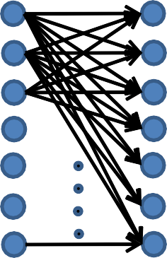
Why Convolutional ?
FC Neural Network
Conv. Neural Network
𝑓 = 5
𝑠 = 1
𝑝 = 0
6 𝑓𝑖𝑙𝑡𝑒𝑟𝑠
𝑓 = 5
𝑠 = 1
𝑝 = 0
6 𝑓𝑖𝑙𝑡𝑒𝑟𝑠
32 ∗ 32 ∗ 3
28 ∗ 28 ∗ 6
32 ∗ 32 ∗ 3
= 3072
28 ∗ 28 ∗ 6
= 4704
6 filters * 5*5*3
= 450 weights + 6 biases
= 456 parameters
3072 ∗ 4704
= 𝟏, 𝟒𝟒, 𝟓𝟎, 𝟔𝟖𝟖 parameters

Slide 78
Why Convolutional ?
 |  |  | 0 | 0 | 0
 |  |  | 0 | 0 | 0
 |  |  | 0 | 0 | 0
10 | 10 | 10 | 0 | 0 | 0
10 | 10 | 10 | 0 | 0 | 0
10 | 10 | 10 | 0 | 0 | 0
10
10
10
1 | 0 | -1
1 | 0 | -1
1 | 0 | -1
0
10
10
10
10
10
10
*
=

Slide 79
Why Convolutional ?
 |  |  |  | 0 | 0
 |  |  |  | 0 | 0
 |  |  |  | 0 | 0
10 | 10 | 10 | 0 | 0 | 0
10 | 10 | 10 | 0 | 0 | 0
10 | 10 | 10 | 0 | 0 | 0
10
10
10
0
1 | 0 | -1
1 | 0 | -1
1 | 0 | -1
0 | 30
10
10
10
0
10
10
10
0
*
=
Parameter Sharing: A feature detector that is useful in one part of the image may also be useful on another part of the same image.

Slide 80
Why Convolutional ?
 |  |  | 0 | 0 | 0
 |  |  | 0 | 0 | 0
 |  |  | 0 | 0 | 0
10 | 10 | 10 | 0 | 0 | 0
10 | 10 | 10 | 0 | 0 | 0
10 | 10 | 10 | 0 | 0 | 0
10
10
10
1 | 0 | -1
1 | 0 | -1
1 | 0 | -1
0 | 30 | 30 | 0
0 | 30 | 30 | 0
0 | 30 | 30 | 0
0 | 30 | 30 | 0
10
10
10
10
10
10
*
=
Parameter Sharing: A feature detector that is useful in one part of the image may also be useful on another part of the same image.
Sparcity of connections: In each layer, output depends only on small number of inputs.

Slide 81
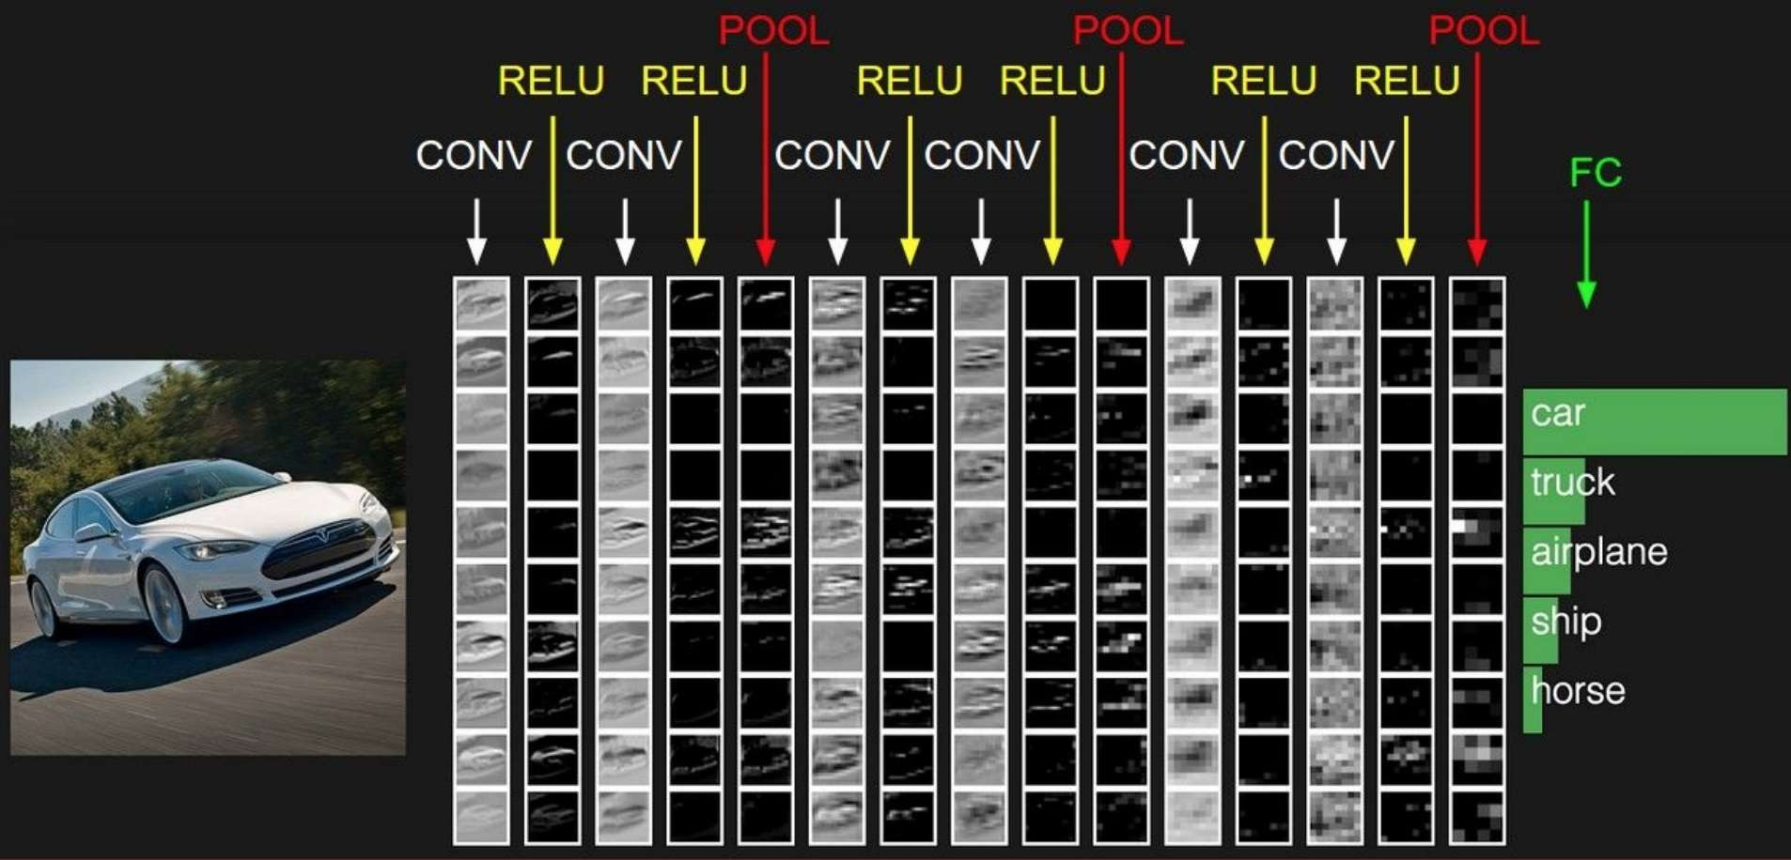
LAYERS IN CNN

Slide 82
A few important terms
Forward pass: Process of passing the data from input layer to output layer.
Cost Function: Difference between the predicted and true output of a NN.
Backpropagation: The process of updating parameters of a network depending on the cost function (using optimization algorithms viz., Gradient Descent, SGDM, ADAGrad, etc.) to minimize the cost.
Mini-batch: Number of images passing at once through the network.
Learning Rate: Speed by which the parameters are updated.
Iteration: A mini-batch performing a forward and a backward pass through
the network is an iteration.
Epoch: When the complete dataset undergoes a forward and a backward pass, an epoch is completed.

Slide 83
Visualize the graph on Tensorboard
tbCallBack = keras.callbacks.TensorBoard(log_dir='./Graph’,
histogram_freq=0,
write_graph=True, write_images=True)
model.fit(...inputs and parameters..., callbacks=[tbCallBack])
If you want to visualize the files created during training, run in your terminal
tensorboard --logdir path_to_current_dir/Graph

Slide 84
Use case: Image classification

Slide 85
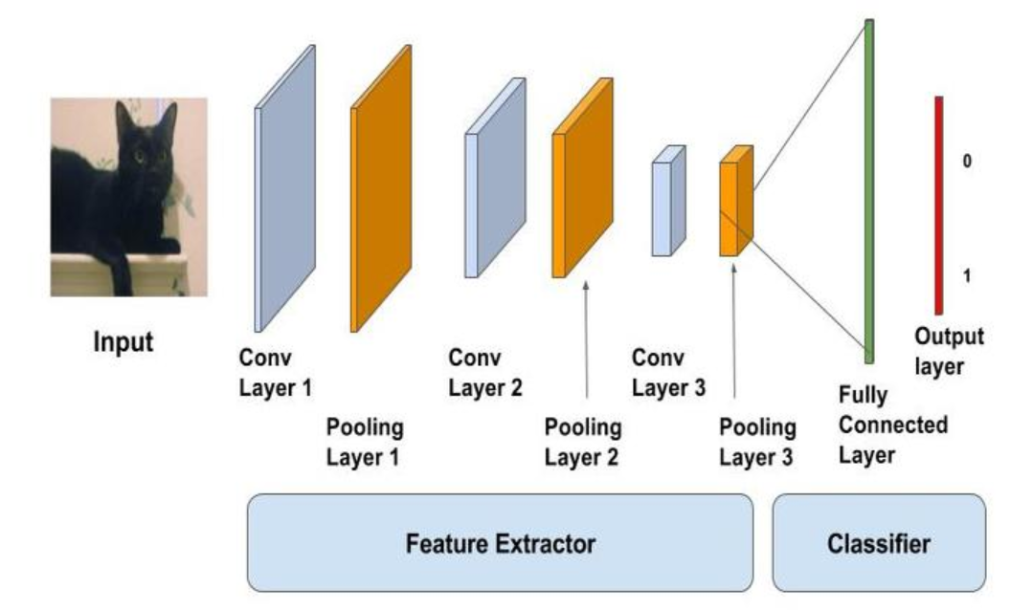
Image Classification on Cifar10

Slide 86
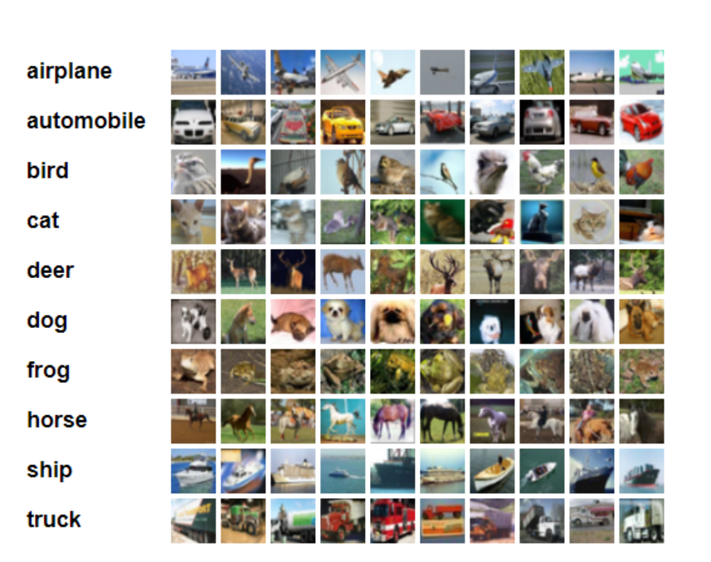
Data set: Cifar10
containing 60.000 different images
size of all images in this dataset is 32x32x3 (RGB)

Slide 87
Load data set
(x_train, y_train), (x_test, y_test) = cifar10.load_data() y_train = to_categorical(y_train, num_classes) y_test = to_categorical(y_test, num_classes)
X_train /= 255.0
X_test /= 255.0
Using one hot encoding to transform the output variable into a binary matrix
Normalizing the data

Slide 88
Structure of the model
We will use a structure with
Two convolutional layers
Followed by max pooling and
A flattening out of the network to fully connected layers to make predictions

Slide 89
Our baseline network structure can be summarized as follows:
Convolutional input layer, 32 feature maps with a size of 3×3, a rectifier activation function and a weight constraint of max norm set to 3
Dropout set to 20%
Convolutional layer, 32 feature maps with a size of 3×3, a rectifier activation function and a weight constraint of max norm set to 3
Max Pool layer with size 2×2
Flatten layer
Fully connected layer with 512 units and a rectifier activation function
Dropout set to 50%
Fully connected output layer with 10 units and a SoftMax activation function

Slide 90
Convolutional layer
model = Sequential() model.add(Conv2D(32, (3, 3), padding='same', input_shape=x_train.shape[1:])) model.add(Activation('relu')) model.add(MaxPooling2D(pool_size=(2, 2))) model.add(Dropout(0.3))

Slide 91
Flatten layer
model.add(Flatten()) model.add(Dense(80)) model.add(Activation('relu')) model.add(Dropout(0.3)) model.add(Dense(num_classes)) model.add(Activation('softmax'))

Slide 92
Fitting model
model.compile(loss='categorical_crossentropy', optimizer=SGD, metrics=['accuracy']) model.fit(x_train, y_train, batch_size=batch_size, epochs=epochs, validation_split=0.2, shuffle=True) scores = model.evaluate(x_test, y_test, verbose=1) print('Test loss:', scores[0]) print('Test accuracy:', scores[1]) model.save('./model' + '.h5')

Slide 93
References
http://www.wildml.com/2015/12/implementing-a-cnn-for-text-classification-in-tensorflow/
https://towardsdatascience.com/a-walkthrough-of-convolutional-neural-network-7f474f91d7bd
http://cs231n.github.io/convolutional-networks/
https://www.youtube.com/watch?v=AgkfIQ4IGaM
https://adeshpande3.github.io/adeshpande3.github.io/A-Beginner's-Guide-To-Understanding-Convolutional-Neural-Networks/
https://www.youtube.com/watch?v=YRhxdVk_sIs

